Slide 2
Intentions for today
Explore what yoga nidra and its benifits
Identify your sankalpa
Practice some yoga postures, breathing and yoga nidra with your sankalpa
To paint your sankalpa in a secret code onto a stone.
Notes:
3 hours
15 mins Sitting Explore what yoga nidra is and its benifist
15 mins meditation and find sankalpa
1.5 yoga class including sankalpa
1 hour painting stone

Slide 3
What is yoga nidra
Ancient tantric practice

Slide 4
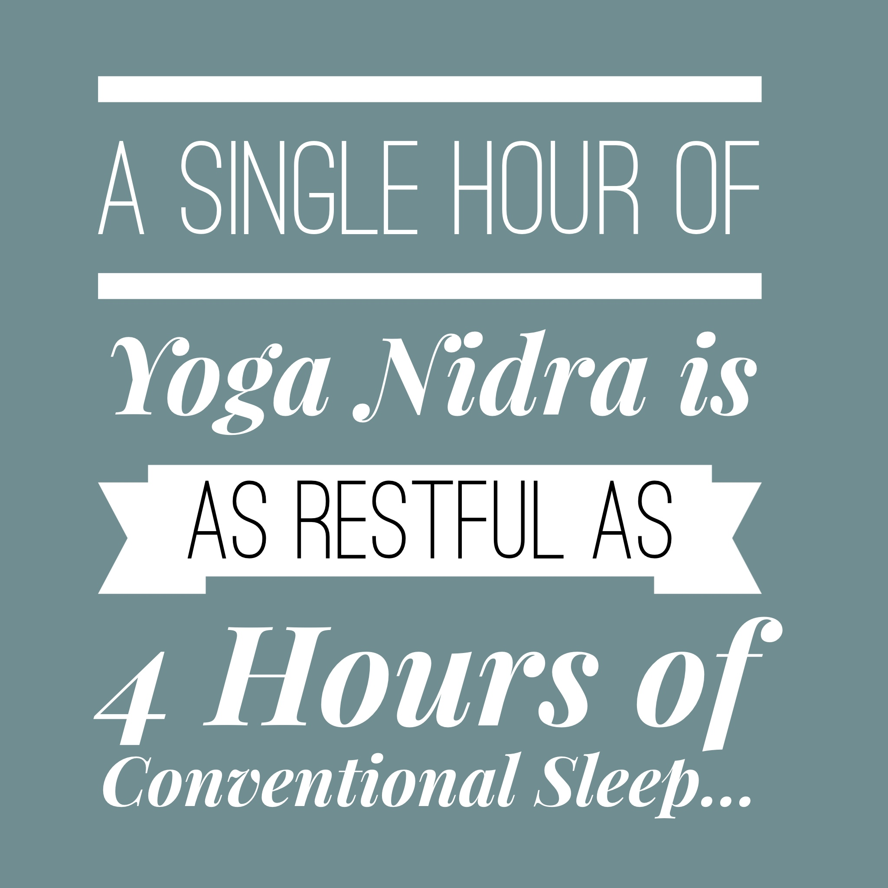

Slide 5
How can it benefit you
Relives stress
Notes:
Question and answer : can you see it benifiting you,

Slide 6
identify areas of your life that need improvement to inform your Sankalpa (positive resolve)
Sankapla always sad in a postive statement, managable in this life time, a realistic sankalpa
Ie I am well and full of joy
I am centred and
Spend some time looking at area that arent so good
Look for opposite word
Disorganise organised
Illness wellness
Depression joyful
Sad happy

Slide 7
Simple yoga postures

